Slide 1

SOFTWARE ENGINEERING TEAM PROJECT
SSE4301:
DEMONSTRATION PRESENTATION
Food Buddy
Group Leader: Muhammad Harith Bin Zainudin
Lecturer`s Name: Dr. Salfarina Abdullah
23th June 2020

Slide 2
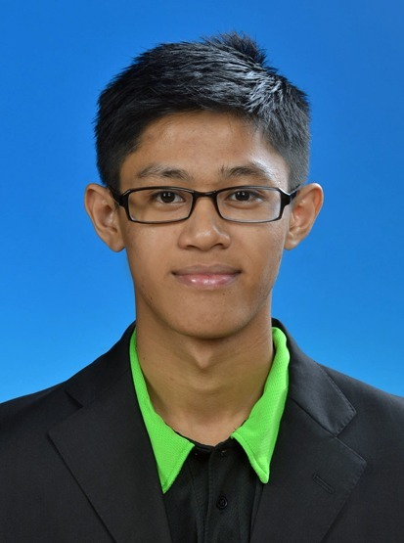
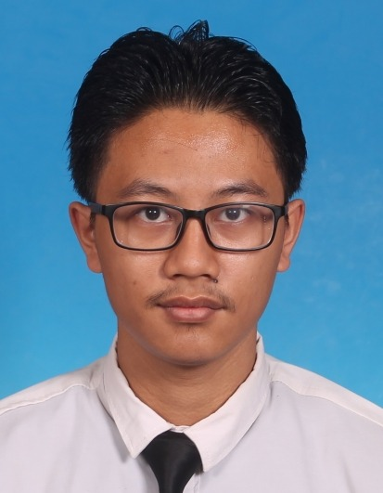
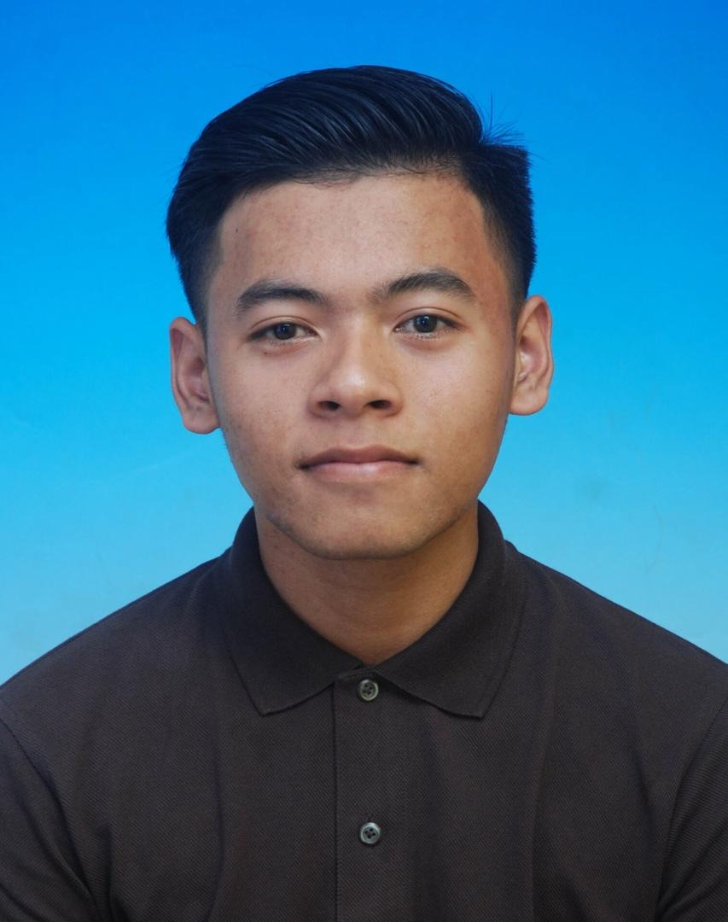
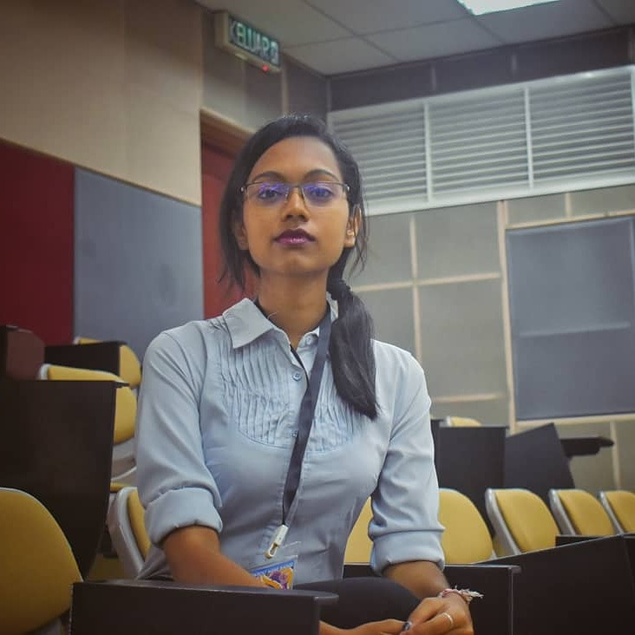
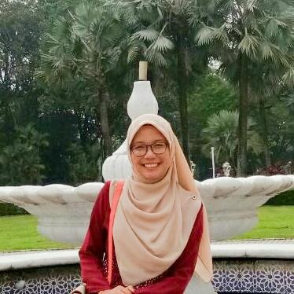
TEAM MEMBERS
Muhammad Harith (192171)
Mohd Shakir Asyraf (193908)
Muhammad Haris
(194701)
Vishwareena Vanoo (194697)
Wan Nur Atiqah (193909)

Slide 3


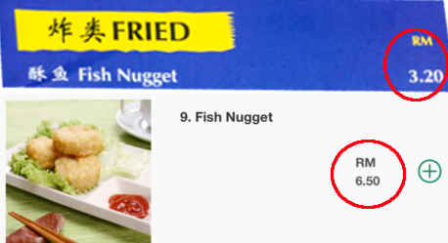
OBJECTIVES
To help students who do not have time or lazy to go out to buy foods.
To help students that have business in university but do not have a proper platform to advertise their product to all the students.
Existing delivery food platforms are expensive for students. Food buddy provide very low delivery charges.

Slide 4
FEATURES FOR INPUT TESTING
Register/ login
Edit User Profile
Add/ Manage Product

Slide 5
INPUT TESTING – Login+
Test Scenario ID | Login-1 |  | Login-1 |  | Test Case ID |  | TC-1
Test Case Description | Login- Positive Test Case |  | Login- Positive Test Case |  | Test Priority |  | High
Pre-Requisite | A valid user account |  | A valid user account |  | Post-Requisite |  | NA
Test Execution Steps:
S.No | Action | Inputs | Inputs | Expected Output | Actual Output | Test Browser | Test Result | Test Comments
1 | Launch Application |  |  | Login Page
2 | Enter correct matric number & password hit Login button | Matric num: 192171 Password: ******** | Email id: xxx@student.upm.edu.my Password: ******** | Login Success

Slide 6
INPUT TESTING – Login- (cont.)
Test Scenario ID |  | Login-2 |  |  |  | Test Case ID |  | TC-2
Test Case Description |  | Login- Negative Test Case |  |  |  | Test Priority |  | High
Pre-Requisite |  | NA |  |  |  | Post-Requisite |  | NA
Test Execution Steps:
S.No | Action |  | Inputs | Expected Output | Actual Output |  | Test Browser | Test Result | Test Comments
1 | Launch Application |  |  | Login Page
2 | Enter invalid matric num & password hit Login button |  | Matric num: 192171 Password: ******** | The matric number that you've entered doesn't match any account. Sign up for an account.

Slide 7
INPUT TESTING – Register+ (cont.)
Test Scenario ID |  | Register - 1 |  |  |  | Test Case ID |  |  | TC-3
Test Case Description |  | Register -Positive Test Case |  |  |  | Test Priority |  |  | High
Pre-Requisite |  | NA |  |  |  | Post-Requisite |  |  | NA
Test Execution Steps:
S.No | Action | Inputs | Inputs | Expected Output | Actual Output | Test Browser | Test Browser | Test Result |  | Test Comments
1 | Launch Application |  |  | Sign Up Page
2 | Enter a name, valid email and valid phone number | Email id: xxx@student.upm.edu.my Password: Phone: 01X-XXX XXXX | Email id: xxx@student.upm.edu.my Password:xxxxx Phone: 01X-XXX XXXX | Sign Up Success and redirected to Login Page

Slide 8
INPUT TESTING – Register- (cont.)
Test Scenario ID |  | Register – 2 |  |  |  |  | Test Case ID |  |  | TC-4
Test Case Description |  | Register -Negative Test Case |  |  |  |  | Test Priority |  |  | High
Pre-Requisite |  | NA |  |  |  |  | Post-Requisite |  |  | NA
Test Execution Steps:
S.No | Action | Inputs | Inputs | Expected Output | Actual Output | Test Browser | Test Browser | Test Result | Test Comments | Test Comments
1 | Launch Application |  |  | Sign Up Page
2 | Enter an invalid email / phone number | Email id: xxx (no @email provider) xxx@yahoo (unfinished email) (blank) Phone: 23 567 (not starting with 01) 01X-XXX XXX (unfinished phone number) (blank) | Email id: xxx (no @email provider) xxx@yahoo (unfinished email) (blank) Phone: 23 567 (not starting with 01) 01X-XXX XXX (unfinished phone number) (blank) | Invalid Input, Please Enter a valid email or phone number

Slide 9
INPUT TESTING – Edit Profile+ (cont.)
Test Scenario ID |  | User Profile - 1 |  |  | Test Case ID |  |  | TC -5
Test Case Description |  | User Profile – Edit profile Positive Test Case |  |  | Test Priority |  |  | Moderate
Pre-Requisite |  | Valid User Account and Logged In |  |  | Post-Requisite |  |  | NA
Test Execution Steps:
S.No | Action | Inputs | Expected Output | Actual Output |  | Test Browser | Test Result |  | Test Comments
1 | Access User Profile Page | Click User Profile Button and edit profile | User Profile
2 | Enter a valid phone number and press Edit Button | Phone: 01X-XXX XXXX Password: xxxxxxx | Updated User Profile Page

Slide 10
INPUT TESTING – Edit profile-(cont.)
Test Scenario ID |  | User Profile – 2 |  |  | Test Case ID |  |  | TC -6
Test Case Description |  | User Profile – Edit profile Negative Test Case |  |  | Test Priority |  |  | Moderate
Pre-Requisite |  | Valid User Account and Logged In |  |  | Post-Requisite |  |  | NA
Test Execution Steps:
S.No | Action | Inputs | Expected Output | Actual Output |  | Test Browser | Test Result |  | Test Comments
1 | Access User Profile Page | Clicks User Profile Button and edit profile | User Profile
2 | Enter an invalid phone number and press Edit Button | Phone: 23 567 (not starting with 01) 01X-XXX XXX (unfinished phone number) (blank) Password: (blank) | Invalid e-mail/blank password Refreshed User Profile with Existing Data

Slide 11
INPUT TESTING – Add Menu+ (cont.)
Test Scenario ID |  | ADD MENU 1 |  |  | Test Case ID |  |  | TC-11
Test Case Description |  | ADD MENU- Positive test case |  |  | Test Priority |  |  | High
Pre-Requisite |  | A valid user |  |  | Post-Requisite |  |  | NA
Test Execution Steps:
S.No | Action | Inputs | Inputs | Expected Output |  | Actual Output | Test Browser | Test Result | Test Comments
 | Enter product name Enter price Enter description Choose picture Upload picture | RECIPE: French Fries PRICE: 30 INGREDIENTS: Potato Choose Available Choose Picture Upload Picture | Product name: French Fries PRICE: RM30 Description: Potato Choose Picture Upload Picture | Uploaded successfully

Slide 12
INPUT TESTING – Add Menu-(cont.)
Test Scenario ID |  |  | ADD MENU 2 |  | Test Case ID | Test Case ID |  |  | TC-12
Test Case Description |  |  | ADD MENU- Negative test case |  | Test Priority | Test Priority |  |  | High
Pre-Requisite |  |  | A valid user |  | Post-Requisite | Post-Requisite |  |  | NA
Test Execution Steps:
S.No | Action | Inputs | Inputs | Expected Output | Actual Output | Test Browser | Test Browser | Test Result |  | Test Comments
1 | Does not enter product name Enter price Enter descriptions Choose picture Upload picture | RECIPE: (blank) PRICE: RM15 Descriptions: Potato Choose Picture Upload Picture | RECIPE: (blank) PRICE: (blank) INGREDIENTS: Potato Choose Available Choose Picture Upload Picture | Request for product name

Slide 13
INPUT TESTING – Add Menu (cont.)
Test Scenario ID |  | ADD MENU 3 |  |  | Test Case ID |  | TC-13
Test Case Description |  | ADD MENU- Negative test case |  |  | Test Priority |  | High
Pre-Requisite |  | A valid user |  |  | Post-Requisite |  | NA
Test Execution Steps:
S.No | Action | Inputs | Inputs | Expected Output | Actual Output | Test Browser | Test Result | Test Comments
1 | Enter product name Does not enter price Enter descriptions Choose picture Upload picture | RECIPE: French Fries PRICE: INGREDIENTS: Potato Choose Available Choose Picture Upload Picture | RECIPE: French Fries PRICE: (blank) Descriptions: Potato Choose Picture Upload Picture | Request for price info

Slide 14
INPUT TESTING – Add Menu (cont.)
Test Scenario ID |  | ADD MENU 4 |  |  | Test Case ID | Test Case ID |  |  | TC-14
Test Case Description |  | ADD MENU- Negative test case |  |  | Test Priority | Test Priority |  |  | High
Pre-Requisite |  | A valid user |  |  | Post-Requisite | Post-Requisite |  |  | NA
Test Execution Steps:
S.No | Action |  | Inputs | Expected Output | Actual Output | Test Browser | Test Browser | Test Result |  | Test Comments
1 | Enter product name Enter price Does not enter descriptions Choose picture Upload picture |  | RECIPE: French Fries PRICE: 15 INGREDIENTS:(blank) Choose Picture Upload Picture | Request for descriptions

Slide 15
INPUT TESTING – Add Menu (cont.)
Test Scenario ID |  | ADD MENU 5 |  |  | Test Case ID |  |  | TC-16
Test Case Description |  | ADD MENU- Negative test case |  |  | Test Priority |  |  | High
Pre-Requisite |  | A valid user |  |  | Post-Requisite |  |  | NA
Test Execution Steps:
S.No | Action |  | Inputs | Expected Output | Actual Output | Test Browser | Test Result |  | Test Comments
1 | Enter product name Enter price Enter descriptions Does not choose picture Upload picture |  | RECIPE: French Fries PRICE: 15 DESCRIPTIONS: Potatoes Upload Picture | Request for choose picture

